Slide 1
Incorporating heterogeneous types of uncertainty in small area estimates from multiple demographic data sources
Lance A. Waller Emily Peterson
Department of Biostatistics and Bioinformatics
Rollins School of Public Health
Emory University
lwaller@emory.edu
git@github.com: Enpeterson/BPOP.git

Slide 2
Incorporating heterogeneous types of uncertainty in small area estimates from multiple demographic data sources
Lance A. Waller Emily Peterson
Department of Biostatistics and Bioinformatics
Rollins School of Public Health
Emory University
lwaller@emory.edu
git@github.com: Enpeterson/BPOP.git

Slide 3
Outline
“Design what you can, model the rest.”
Compromise Models:
Differential privacy
Small area estimation
Small area population data sources
Hybrid, model-based estimation of small area population sizes.
“Design what you can, model the rest.”

Slide 4
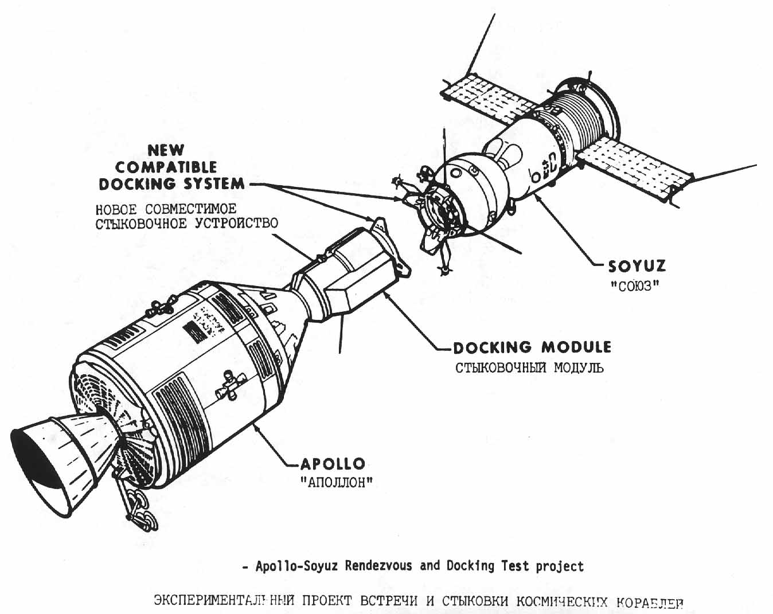
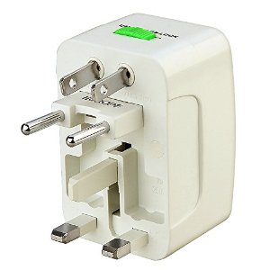
Specific vs. general solutions
Customized technical solution to
very specific problem (“just right”)
Framework that works pretty well
most of the time.
http://history.nasa.gov/diagrams/astp/pk69.jpg

Slide 5
Acknowledgements
Support: NICHHD R01: 5R01HD092580
Emory University, Rollins School of Public Health
Lance Waller, Emily Peterson
Harvard T.H. Chan School of Public Health
Brent Coull, Nancy Krieger, Jarvis Chen, Rachel Nethery, Yanran Li, Christian Testa, Nick Link
Imperial College, London
Fred Piel, Marta Blangiardo, Paul Elliott, Mahboubeh Parsaeian
Drexel University
Loni Tabb

Slide 6
Compromises: SAE and DP

Slide 7
Small Area Estimation
Fay & Herriot (1979, JASA)
Shrinkage estimation, James-Stein estimation
Random intercepts borrow information
From overall mean (SAE)
From neighbors (Clayton and Kaldor 1987, Bcs)
From both (Besag, York, Mollié 1991, Ann Inst Stat Math)
Elegant mathematics to borrow the right amount of information.

Slide 8
“Design what you can, model the rest.”

Slide 9
Differential Privacy
Statistical summaries vs. needle-in-a-haystack
(Dwork IPAM-UCLA presentation on YouTube)
Metaphor: 20 questions
Questions are statistical summaries
“20” = privacy budget (debit card vs. credit card)
Differential privacy caps probability of discovery from statistical summaries
Elegant mathematics to add the right amount of noise.

Slide 10
“Design what you can, model the rest.”

Slide 11
Putting data to use
A lot of research on differential privacy
US Census Bureau
Applied to 2020 US Census data products.
Provided in 2010 demonstration products.
Impact on small area inference?
Measurement error?
How to account for differential privacy-induced bias in small area estimates?

Slide 12
Differential Privacy and Small Area Estimation

Slide 13
Differential Privacy and Small Area Estimates
2010 (yes, 2010) US Census demonstration data product
Both old and new (DP) disclosure avoidance.
Releases in 2019, 2020, 2022 (spoiler alert: version is important!)
Two recent assessments relating to small area health disparities:
Kurz et al (2022, Health Services Research), Waller (2022 commentary)
Li et al. (2023, Science Advances)

Slide 14
Kurz et al. (2022, HSR)
Kurz et al (2022):
County-level 2010 population counts and local Medicaid participation.
Racialized subpopulations.
County-level: Differential privacy introduced errors up to 10% in counts and proportions of local Medicaid populations.
State-level: Negligible errors in race-specific Medicaid participation.

Slide 15
Waller (2022, HSR, Commentary)
Decennial Census
Number of residents on particular day.
American Community Survey
Rotating survey estimate averaged over a period of time.
Includes margins of error.
Spatial correlation in estimates (high values near high values).
Spatial correlation in margins of error (noisy values near noisy values).
Different data products require care in combining!

Slide 16
Ingredients
Technical
What kinds of errors and uncertainty.
Read the documentation!
Conceptual
Measurement error:
Classical: Estimates vary around the true (unknown) value.
Berkson: Truth varies around the reported estimate.

Slide 17
Closer look at 2010 Demonstration Products
From the documentation…
Li et al. (2022, Sci Adv) compare:
Original 2010 decennial census tract data (DC, data swapping)
Oct 2019 demonstration product (DP19, differential privacy)
May 2020 demonstration product (DP20, updated differential privacy)
August 2022 demonstration product (DP22, most recent differential privacy)
Notes:
DP19, DP20: identical DP, distinct postprocessing
DP22: revised DP parameters in response to users (increased privacy-loss budget, giving greater accuracy and weakening privacy guarantees).

Slide 18
Differential Privacy and Small Area Estimation
DP22
DP19, DP20

Slide 19
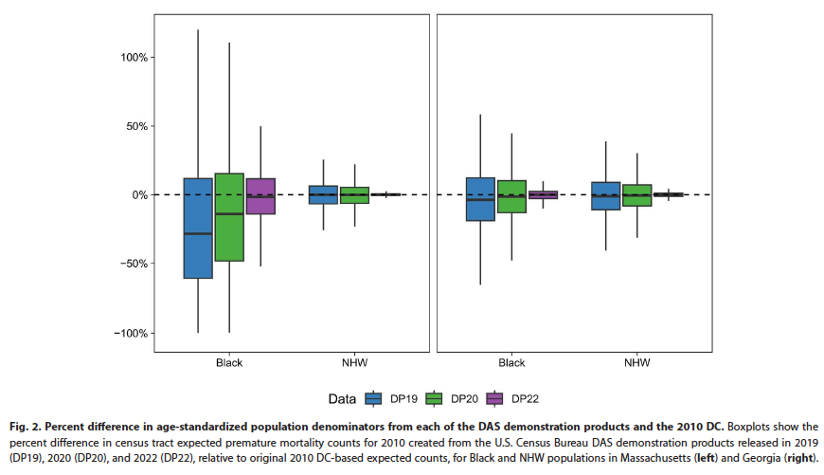
% difference in age-standardized population

Slide 20
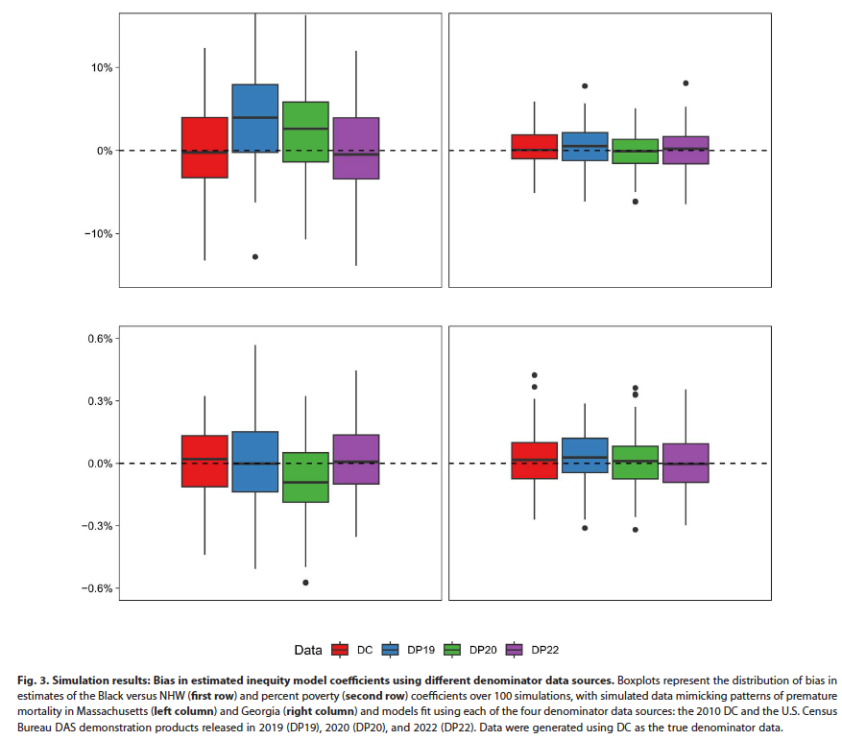
Simulation assessments of bias

Slide 21
Next: combining disparate data products
Small area population: How many people there?
Nethery et al.: Comparing US Census data and non-Census data
American Community Survey
WorldPop
Peterson et al.: Combining US Census Bureau products:
Decennial
PEP
American Community Survey
What types of uncertainties?

Slide 22
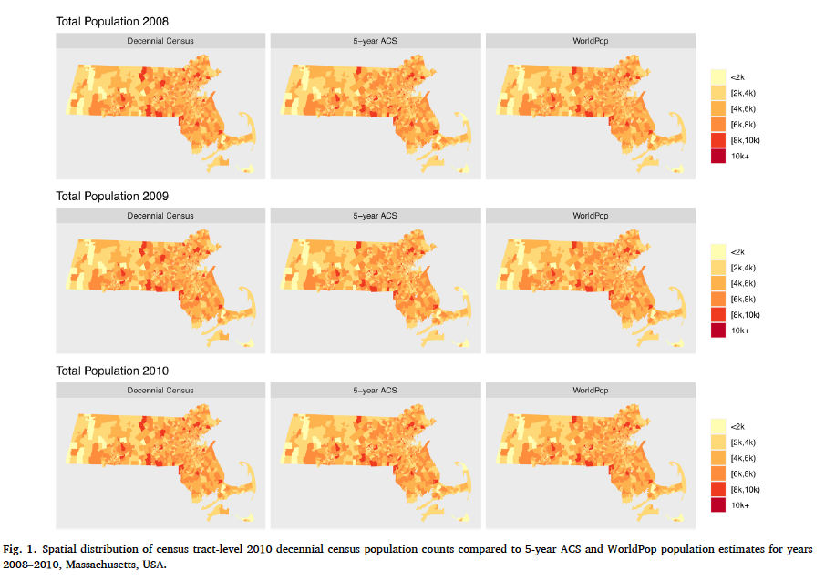
Comparing ACS and WorldPop
Nethery et al. (2021, SSM Population Health)

Slide 23
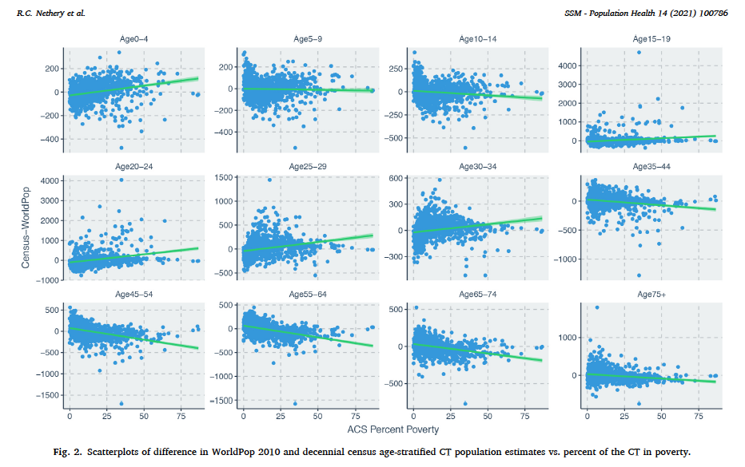
Accuracy vs. % poverty

Slide 24
Combining US Census Data Products
Peterson et al.: Combining US Census Bureau products:
Decennial (Census)
PEP (Demographic Model)
American Community Survey (Rotating surveys)
https://doi.org/10.1214/23-AOAS1849
Each product includes different types (and sources) of measurement error.

Slide 25
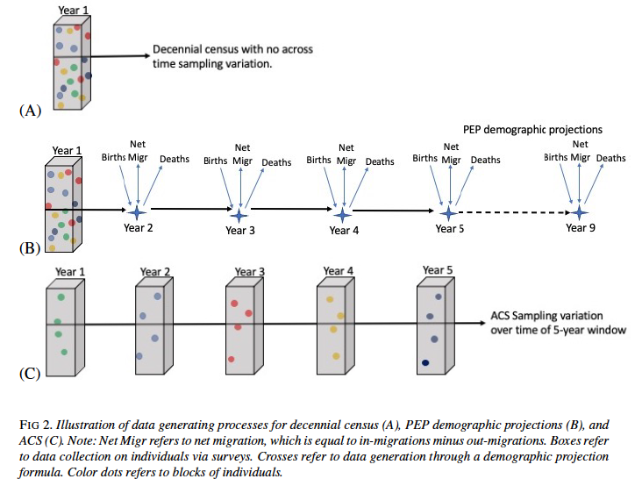
Sources of
Error
Decennial
Undercount
Demographic
errors
PEP
Sampling errors,
temporal aggregation
ACS

Slide 26
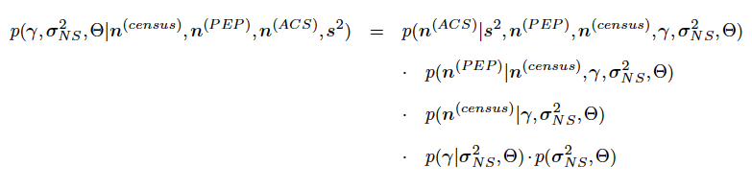
Modeling different types of error
Hierarchical structure
Sampling error
True population
Population estimates
Has a Berkson error flavor…
Non-sampling error

Slide 27
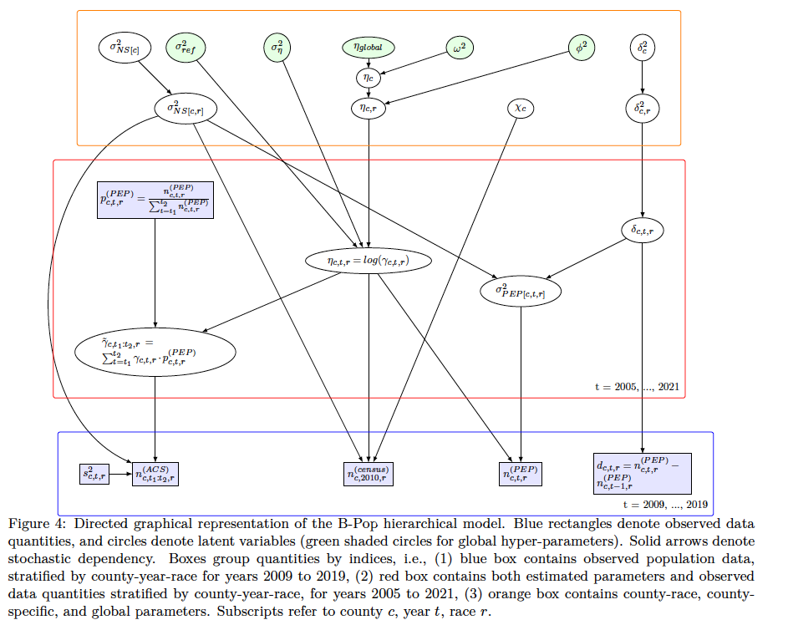
1000 words

Slide 28
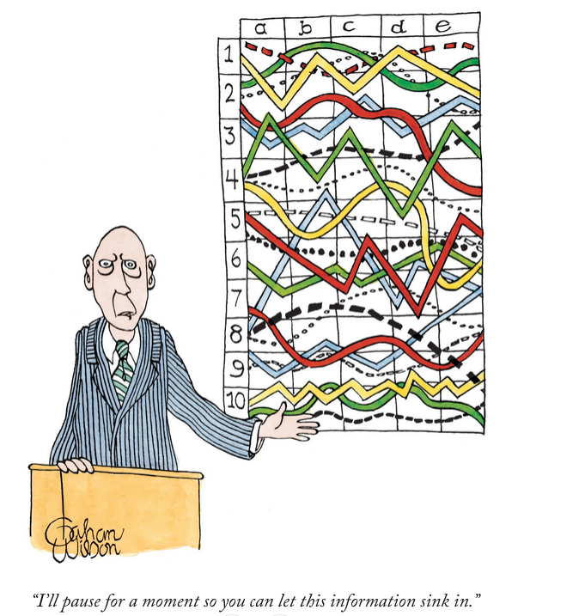
https://www.newyorker.com/culture/postscript/the-beautifully-macabre-cartoons-of-gahan-wilson

Slide 29
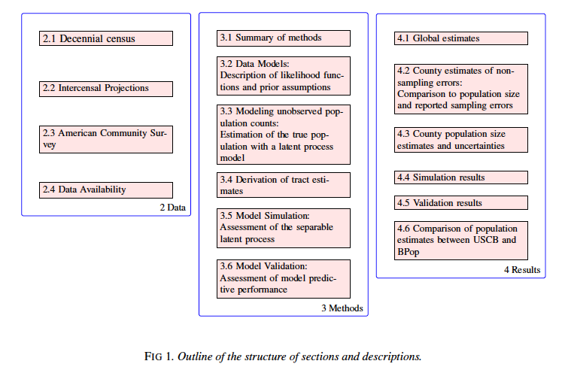
A new type of map (for me)….

Slide 30
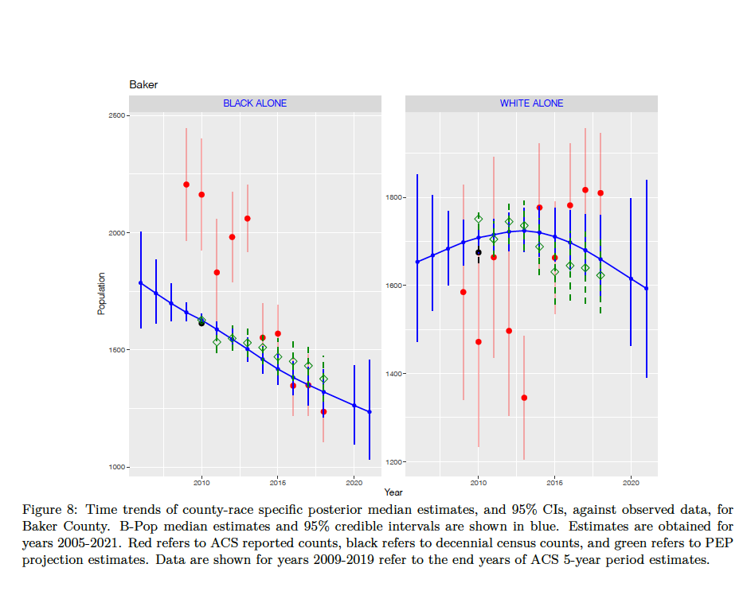
Predictions: Baker County

Slide 31
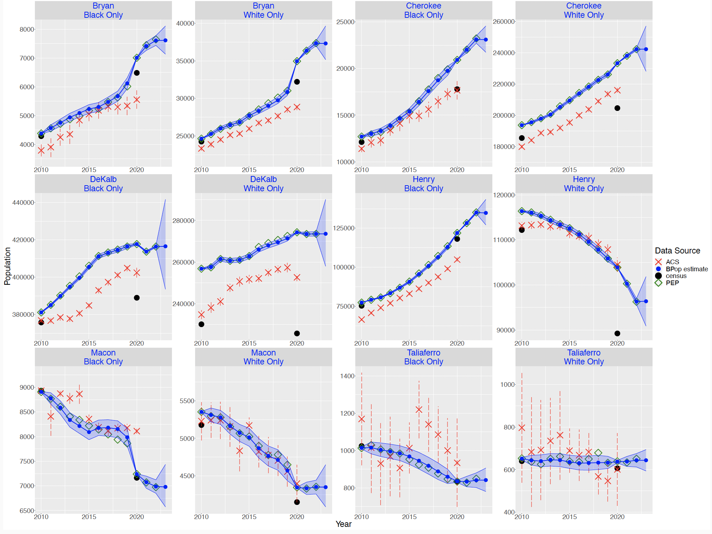
High population:
PEP catches growth,
ACS lags
Low population:
PEP catches growth,
ACS noisier

Slide 32
Summary
Compromises: Differential privacy and small area estimation
Tension in goals, math to balance
Differential Privacy and Small Area Estimates of Health Disparities
Updated privacy budget improved accuracy
Hybrid, model-based estimation of small area population sizes.
Tracking sources and types of uncertainty (challenging, but important)
“Design what you can, model the rest.”

Slide 33
References
Peterson EN et al. (2024) A Bayesian hierarchical small area population model accounting for data source specific methodologies from American Community Survey, Population Estimates Program, and Decennial Census Data. Annals of Applied Statistics 18(2): https://doi.org/10.1214/23-AOAS1849
Nethery et a. (2021) Comparing denominator sources for real-time disease incidence modeling: American Community Survey and WorldPop. SSM-Population Health 14, 100786. https://doi.org/10.1016/j.ssmph.2021.100786
Li Y et al. (2023) Impacts of census differential privacy for small-area disease mapping to monitor health inequities. Science Advances 9, eade888.
Kurz CF, König AN, Emmert-Fees KMF, Allen LD. (2022) The effect of differential privacy on Medicaid participation among racial and ethnic minority groups. Health Serv Res. 57(Suppl. 2):207‐213. doi:10.1111/1475-6773.14000
Waller LA. (2022) Global and local impacts of differential privacy on estimates of health care inequity. Health Serv Res. 57(Suppl. 2):204‐206. doi:10.1111/1475-6773.14080

Slide 34
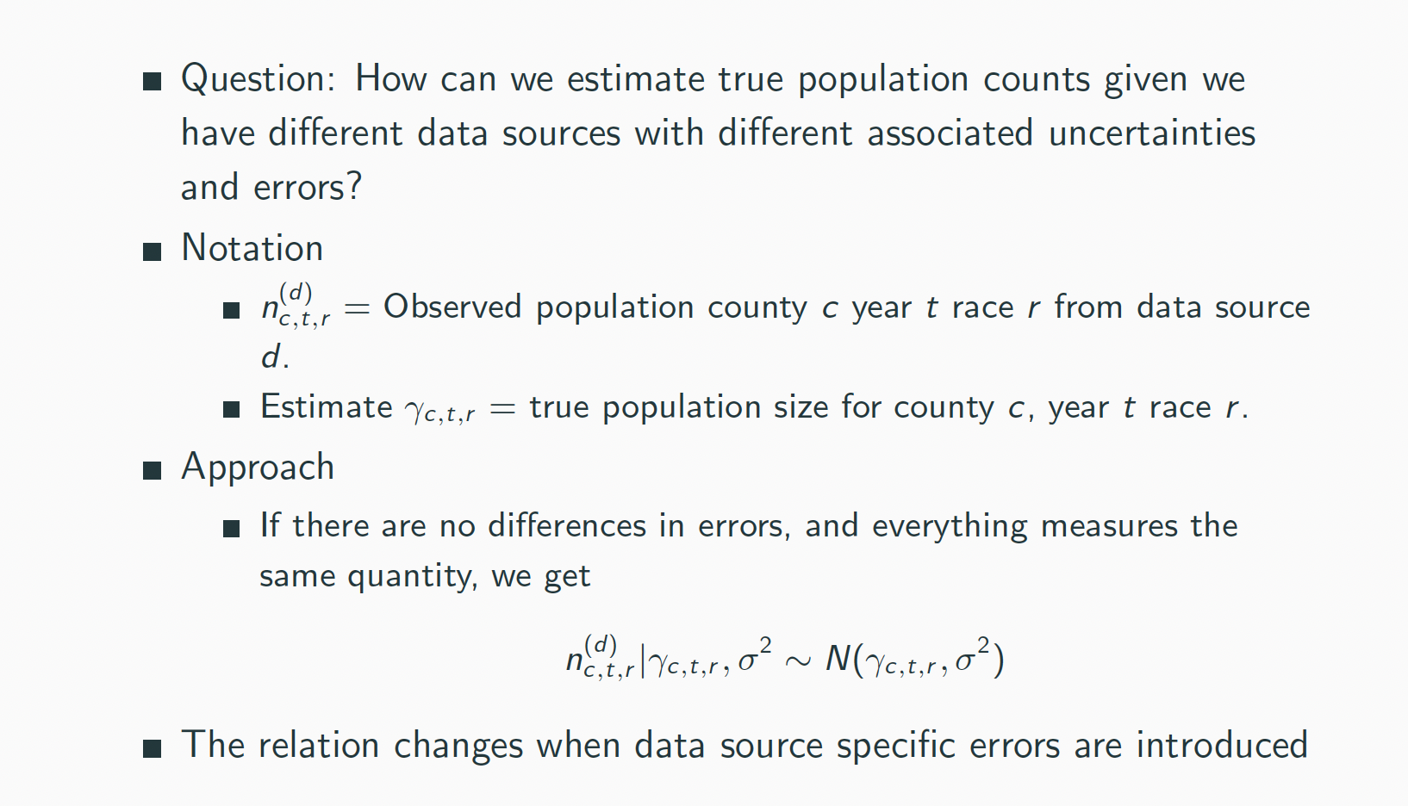
TO ADD TO YOUR SLIDES IF YOU WANT (EP). I don’t know if you want to add specific data models. Put them at the end.

Slide 35
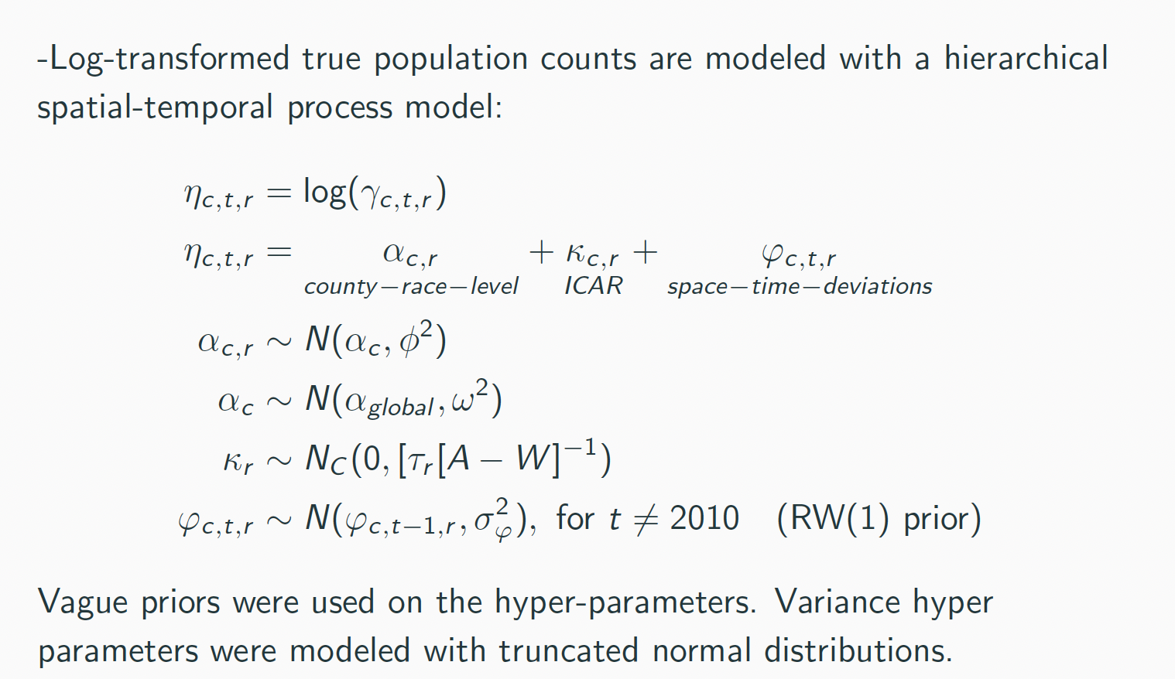
TO ADD TO YOUR SLIDES IF YOU WANT

Slide 36
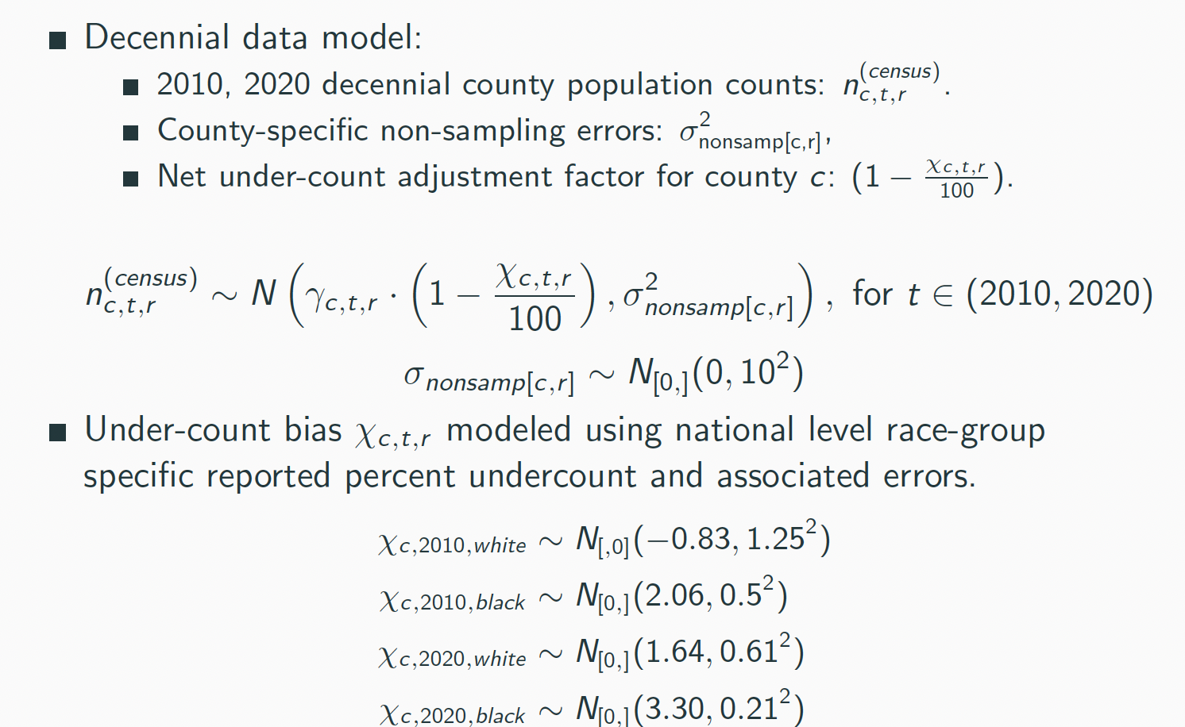

Slide 37
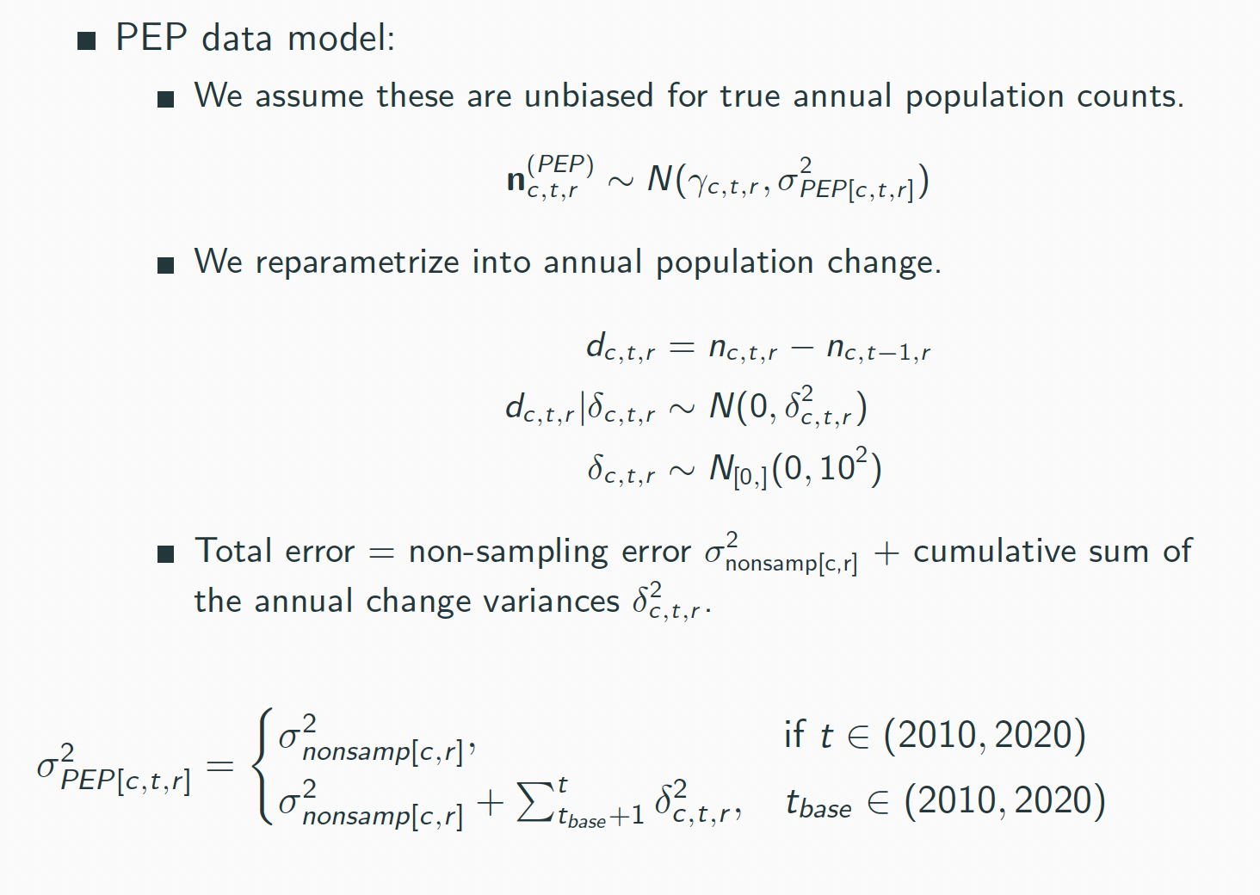

Slide 38
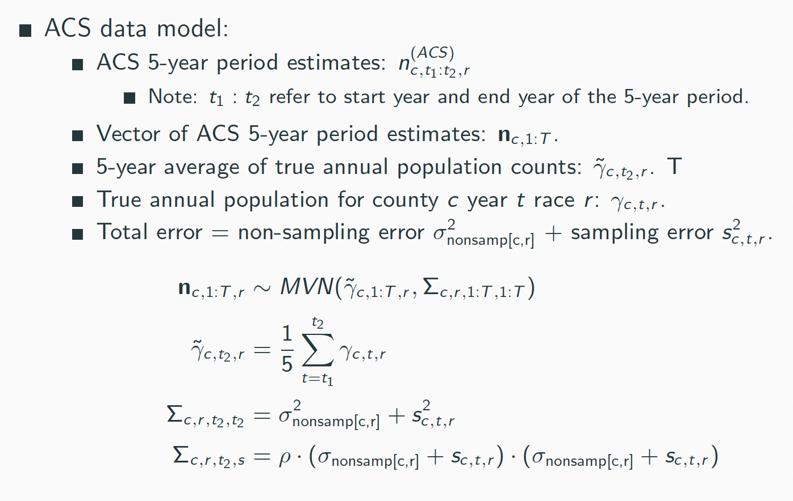

Slide 39
